Slide 1
IS739 INFORMATION SYSTEMS IN ORGANIZATIONAL DESIGN AND APPLIED SYSTEM THINKING Organizational Design: A Step-by-Step Aproach Step 3: Structure The Configuration and Complexity of the Firm
ANIL ARPACI

Slide 2
The step-by-step approach
Step 1: Getting started
Step 2: Strategy
Step 3: Structure
The configuration and complexity of the firm
Distributed organizations
Step 4: Process and people
Step 5: Coordination and control

Slide 3
Introduction
Choice of configuration: a critical decision for the executive
Poor choice of configuration: opportunity losses
Configuration: pictured as organizational chart
Two complementary problems of organizational design:
How to partition a big task into smaller basic tasks
How to coordinate these smaller tasks

Slide 4
Introduction (cont.)
Organizational complexity specifies organizational design
Organizational complexity:
Horizontal and vertical differentiation
Number of departments
Number of vertical levels

Slide 5
Configuration
Two fundamental dimensions to distinguish the basic configurations
Product/service/customer orientation:
Task will be partitioned by output of the firm.
External focus.
Departments with products and customer names
Functional specialization
Work will be divided by specialized activities
Internal focus
Departments with function names

Slide 6
Configuration (cont.)
Product/service/customer and functional dimension indicate how the work will be divided
These two dimension of configuration generate four basic configurations:
Simple
Functional
Divisional
Matrix

Slide 7
Configuration (cont.)
Functional specialization
High
Functional
Matrix
Low
Product/service/customer orientation
High
Simple
Divisional
Low

Slide 8
Simple configuration
Low on product/service/customer dimension
Low on functional specialization dimension
A small organization: an executive and a few individuals
The executive assigns the tasks and coordinates.
The executive is at the center of information flow

Slide 9
Simple configuration (cont.)
Sophia
Top Manager
George
Jane
Jens

Slide 10
Simple configuration (cont.)
Simple configuration is usual for small firms
Simple configuration is flexible but not efficient and effective
The employees are asked to do many tasks
It can be difficult for the executive
To adjust firms direction
Seek innovative opportunities
It is the executive’s show
If executive uses time well, make good decisions, coordinates activities well, it leads to good performance

Slide 11
Functional configuration
Low on product/service/customer dimension
High on functional specialization dimension
More complex than simple configuration
There are department managers and well-defined jobs
The total task of the firm is broken down and assigned to subunits
The executive at the center
Making decisions
Coordinating activities

Slide 12
Functional configuration (cont.)
Headquarters
Top Management
Supply: Materials, Labor, Equipment
Manufacturing
Sales
Information Flow
Product Flow

Slide 13
Functional configuration (cont.)
Advantage of functional configuration is that specialization provides rationale to assign individuals and subunits to specific tasks
Most common configuration
The main question about functional configuration
How many subunit functions should there be? (the limited time of the executive and the capacity of the subunits)

Slide 14
Functional configuration (cont.)
The number of subunits or products increase, the coordination demand increase non-linearly ( a few functional subunits are possible)
NK complexity theory shows that where N is the number of subuints and K is the degree of interdependent information flow, K=N-1, the coordination demand become overwhelming quickly as the number of subunits increases

Slide 15
Functional configuration (cont.)
Like simple configuration, the executive in the functional configuration is at the center and may be overloaded if the environment is not predictable
When adjustment and change are required, the situation can be overwhelming
The functional configuration is efficent for unchanging activities
A good choice when you want the organization to operate with high efficiency and precision
Works well for tasks repeated frequently and in high volume

Slide 16
Divisional configuration
High on product/service/customer dimension
Low on functional specialization dimension
Focus on the outside products, services and the customers
There is an executive level and independent subunits (division)
Each division has its own markets and customers
The executive is like a bank
Divisional configuration works best when coordination is limited, each division runs its own business

Slide 17
Divisional configuration (cont.)
Headquarters
Top Management
Division 1
Division 2
Division 3
Market
Market
Market
Information Flow
Product Flow

Slide 18
Divisional configuration (cont.)
Each division, the organization can be configured as a simple or functional configuration
The advantage of the rationale for the divisional configuration: to be effective with external focus on the product, customer or region
More-market responsive than functional configuration
New acquisitons as divisions

Slide 19
Divisional configuration (cont.)
The disadvantage of divisional configuration is that each division is independent, does not handle interdivisional dependencies
The executive of divisonal configuration is responsible for
Choice of divisons
Their level of activity
Firm performance

Slide 20
Divisional configuration (cont.)
How many divisions should a firm have?
Unlike functional configuration, additional divisions do not increase coordination demand.
It requires choosing an executive for the division and adding one more column to the financial report
In term of NK complexity theory, K is very low.
Number of divisons can be quite large.

Slide 21
Matrix Configuration
The Basic Configurations
Functional Specialization
High
Efficiency
Simple
Matrix
Effectiveness
Product / service / customer orientation
Low
High
Functional
Divisional
Low
Notes:
As u can see on the Figure, The matrix configurations is high on both dimensions: product/ service / customer and functional specialization.
So suggesting a need for a high information-processing capacity to achieve the twin goals of efficiency and effectiveness.

Slide 22
Matrix Configuration
The top executive
Functional and divisional dimensions
Policies, priorities
Matrix managers
Difficult coordination problems
Multiple variable tradeoffs
Notes:
The top executive is responsible for both the functional and divisional dimensions – to set policy, set priorities and resolve conflicts among the subunits.
The matrix managers can deal with most of the difficult coordination problems. They make multiple variable tradeoffs which involve both the function and the division.

Slide 23
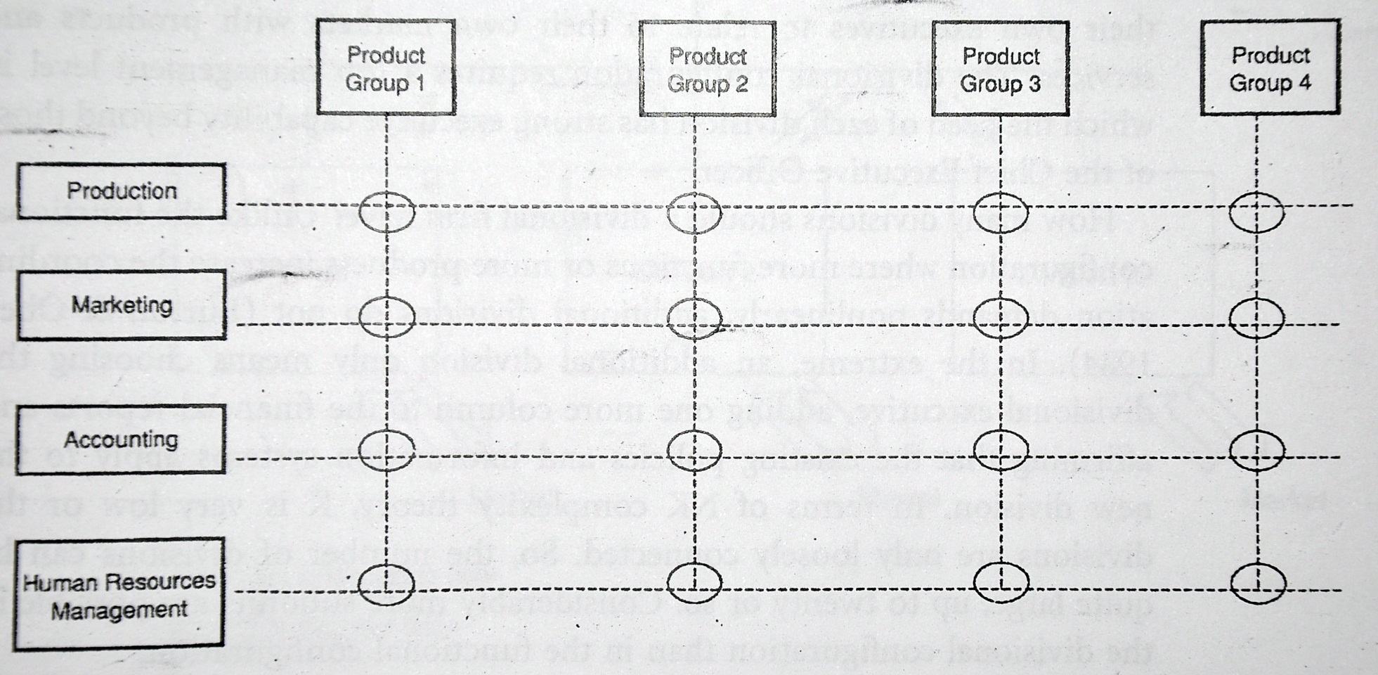
Matrix Configuration
Functional Specialization
Jello effect: When there is a change in the timing of an activity, it ripples across the whole of the firm
Notes:
As u can see it is a matrix and matrix configuration requires simultaneous coordination of the functional specialties across the projects, products, services or customers that the firm services.
When there is a change in the timing of an activity, it ripples across the whole of the firm and called jello effect.

Slide 24
Matrix
Flexible
Dealing with new info
Adjusting to new situation
Efficiency of the functional form
Effectiveness of the divisional form
Advantages
Lateral and vertical subunits
Information overload
Excessive meeting
Decision delay.
Challenges
Notes:
The matrix can be very flexible, dealing with new information and adjusting to the new situations quickly to utilize limited resoruces to meet firm priorities.
The advantege is that the matrix can realize both the efficiancy of the functional form and the effectiveness of the divisional form.
When the matrix works well, both efficiancy and effectiveness result.
The challenges of managing a matrix include agreement conflicts between the latarel and vertical subunits, information overload, excessive meeting and desicion delay.
The matrix configuration requires managerial skills.

Slide 25
Matrix Configuration
Two dimensional names
Product and customer
Product and country so on.
Three dimensional names
Product,function and country.
Four dimensional names
How big can a matrix?
Jello effects
NK theory
Notes:
The matrix configuration has many dimensional names.
Matrix relations go beyond setting up the matrix configuration reporting relationship.
Management must invest in developing cross-organizational coordination.
The matrix has both a functional and divisional dimensionto manage. So the size is the number of functions multiplied by the number of divisons. Given the jello effects or more formally in NK theory. N is the number of subunits and K is the degree of interdependency. The book suggests that the matrix should include small number of subunits. Because the matrix can be too complex to manage.

Slide 26
Matrix Configuration
Efficiency and effectiveness → matrix configuration
Management→ Efficiency and effectiveness
Poor performance→ The dual coordination
Notes:
When both efficiency and effectiveness are needed, the matrix configuration is an appropriate choice.
The matrix is usually more costly to manage than a hierarcy.Because there are more managers, more informations, and more complicated coordinatioan to be done.
The top management in the matrix has a focus on both efficiency and effectiveness.
It is important to emphasize that the matrix can also lead to poor performance. Since, the dual coordination acroos the functions and the divisions can lead to conflicts of priorities btw the managers of subunits.
The organizational complexity is another property of the organization to reach goals of efficiency and effectiveness.

Slide 27
Organizational Complexity
A property or characteristic
Vertical and horizontal differentiation (OC dimensions)
HD: the degree of task specialization or width.
VD: the depth of hierarchy or height.
Efficiency and effectiveness
Notes:
The organization’s complexity is a property or characteristic of the organizational structure.
Organizational complexity is the vertical and horizontal differentiation of task management in the firm. It is how the firm’s configuration is broken down into its severel subunits.
OC dimentions are vertical and horizontal differentiations.
These design choices are to be made in terms of efficiency and effectiveness goals.

Slide 28
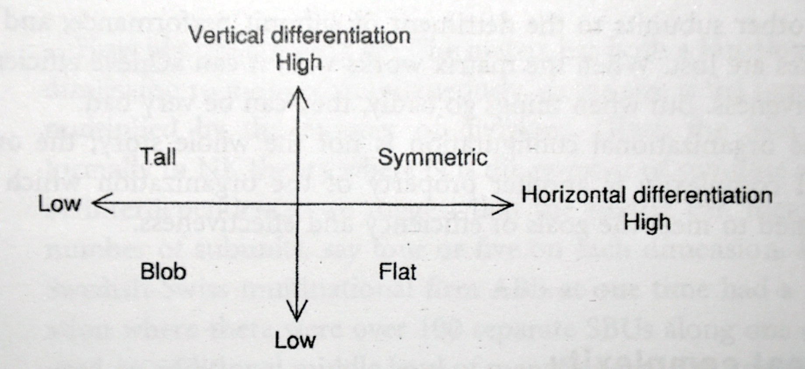
Organizational Complexity
Notes:
The organizational complexity is classified as:blob,tall,flat,and systematic.

Slide 29
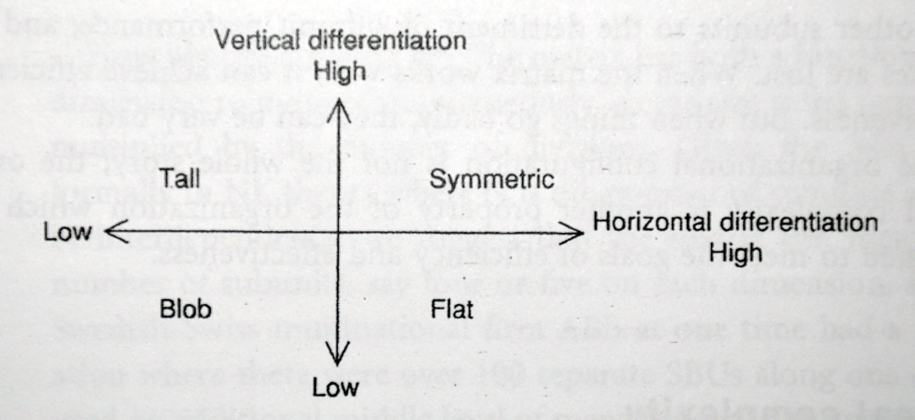
Blob
Firm → not dividing its work into subunits
Undifferentiated
Low
Firm→ flexible and quick to respond
Confusing for customers because of lack of definitions.
Notes:
If the firm doesnt formally divide its work into subunits, then it is like a blob.
It is undifferentiated, it is low on both horizontal and vertical differentiation.
For blob, the firm can be flexible and quick to respond to ongoing changes.
Also, there is not defination about who is to do what, where should go for information. So it is confusing.

Slide 30
Tall
Low on HD, high on VD.
Middle management focusing on information processing.
The middle managements takes directions and orders from the executive and breaks them down into smaller task implications. And implications must be coordinated across the subunits.
Notes:
The tall firms low on horrizontal differentiation and high on vertical differentiation.
The tall firm has a large middle management which focuses on information processing.
The middle managements takes directions and orders from the executive and breaks them down into smaller task implications.And implications mucst be coordinated across the subunits.

Slide 31
Flat
High on HD, Low on VD.
Fewer middle managers coordinating between the top executives and the lower levels in the organization.
Focusing on resource allocation, general policy and finance → Short term information
Advantage→Autonomy to focus on its own work
Notes:
The flat firms high on horrizontal differentiation and low on vertical differentiation.
There are fewer middle managers to coordinate btw the top executives and the lower levels in the organization.
The middle managers focus on on resoruce allocation, general policy and finance. Short-term information exchanges focus on financial goals and cash flows.
The major advantage of the flat organizational structure is that each unit has autonomy to focus on its own work.

Slide 32
Symmetric
High on HD, high on VD.
The organization’s work is broken down into many task specialties as well as many vertical levels.
The information-processing requirements are high.
Notes:
The symmetric firms high on horrizontal differentiation and high on vertical differentiation.
This means that the organization’s work is broken down into many task specialties as well as many vertical levels.
The systematic organizations tries to hit ideal balance of vertical and horizontal breakdown of work into subunits.
The information-processing requirements of the symetric organization are very high, because the coordination demends are high both horrizontally and vertically throughout the firm.

Slide 33
FIT & MISFITs
Questions:
What is a good configuration for your firm?
What is an appropriate organizational complexity?
Previously goals, strategy and environment evaluated
Now, fit for Configuration and Organizational Complexity will be added

Slide 34
Why Important?
Misfits
overload the executive management
Decrease performance of firm
What is Misfit?
Any set of relations which do not fall within one column (in the following table)
There are very large number of possible misfits

Slide 35
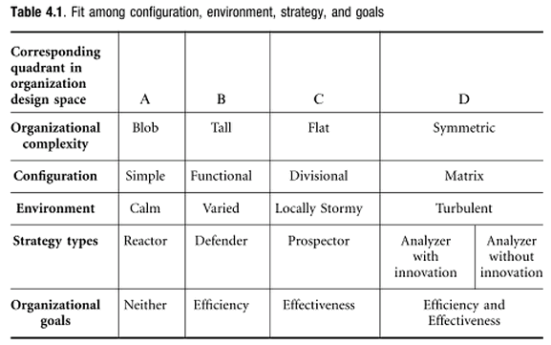
Fit Table

Slide 36
Column A
Fits:
Organizational Complexity: Blob
Configuration: Simple
Environment: Calm
Strategy Type: Reactor
Organizational Goals: Neither (ill-defined goals)

Slide 37
Column A
Executive has time and can devote attention to low information processing demands
If more information processing required, he/she becomes overloaded.
Simple config. misfits with other conditions (such as defender strategy, varied environment… ) since they generates information processing demands.
Reactor is a good fit for Blob + Simple. It lacks focus on goals and is reactive to the situation at hand.
Simple config. works well with Calm environment (predictable and not complex) since there are fewer adjustments required.

Slide 38
Column B
Fits:
Organizational Complexity: Tall
Configuration: Functional
Environment: Varied
Strategy Type: Defender
Organizational Goals: Efficiency

Slide 39
Column B
Information processing demand increased, but Tall complexity and functional config. can handle this.
Tall firm misfits with innovation focused strategies.
Defender wants to keep things as they are; functional config. fits well.
functional + tall fits well with Varied env.which is predictable and has high complexity
When the env. becomes unpredictable (turbulent or locally stormy) functional config. loses efficiency.

Slide 40
Column C
Fits:
Organizational Complexity: Flat
Configuration: Divisional
Environment: Locally Stormy
Strategy Type: Prospector
Organizational Goals: Effectiveness

Slide 41
Column C
Each division has its own env. which is stormy and independent.
Executive can create independent divisions to deal with local conditions.
If env. becomes interdependent (two division may compete for the same customer), executive becomes overloaded (misfit).
Divisional config. fits well with prospector where each division’s strategy is not specified from top, but is developed within own markets and resources

Slide 42
Column D
Fits:
Organizational Complexity: Symmetric
Configuration: Matrix
Environment: Turbulent
Strategy Type: Analyzer with/without innovation
Organizational Goals: Efficiency and Effectiveness

Slide 43
Column D
Information processing demands are very large.
Detailed coordination of new situations required.
Firm can’t be broken down into independent parts.
Matrix config. is appropriate when the strategy has dual focus and env. is turbulent.
Analyzer operates in 2 domains:
Exploitation of existing business (efficiency important)
Exploration of innovation (effectiveness important)
Matrix config. brings them together to realize the needed changes in a timely manner.

Slide 44
To Sum Up
Configuration and organizational complexity
Types and Importance
Relations with strategy, environment and goals
Fit and Misfit situations
One final question: If there are misfits, what to do?
Consider how these might be changed in order to bring them into alignment (fit). Do not ignore what is involved to move to a different column.

Slide 45
References
Burton, R. M., Obel, B., & Håkonsson, D. D. (2015). Organizational design: A step-by-step approach. Cambridge University Press.
Siggelkow, N., & Rivkin, J. W. (2005). Speed and search: Designing organizations for turbulence and complexity. Organization Science, 16(2), 101-122.

Slide 46
Thank you for listening ☺
Question?

